Slide 1
ESTIMATION OF BUSINESS EXPENSES
PROJECT REPORT

Slide 2
INTRODUCTION
1.1. OVERVIEW
This involves estimating all the expenses required to start and operate the business, such as equipment, rent, inventory, and marketing. By calculating these costs upfront, business owners can better plan their budget and avoid unexpected expenses.
Most people are aware of spreadsheets, and for many years they have been used to keep track of spending. It does not guarantee that your records will always be safe, correct, or up to HMRC inspection standards, even if you update your costs and receipts frequently and have a well-organized file system.Using a spreadsheet manually can be time-consuming and divert your attention from other crucial business duties. According to studies, spreadsheets also contain inaccuracies in over 88% of cases. Therefore, you may be providing HMRC with false information or missing out on claimable expenditures.

Slide 3
1.2. PURPOSE
Estimates are important because they allow businesses to set expectations for their customers. They also help businesses determine whether or not a project is feasible and how much profit they can expect to make. Estimating also allows businesses to plan for unforeseen expenses and keep track of spending.
The purpose of cost estimation is to give project stakeholders accurate information concerning the related project costs. It is easier to make lasting decisions if there is information to back them up. Cost estimation also gives clients value-aided options and helps clients minimize expenses.

Slide 4
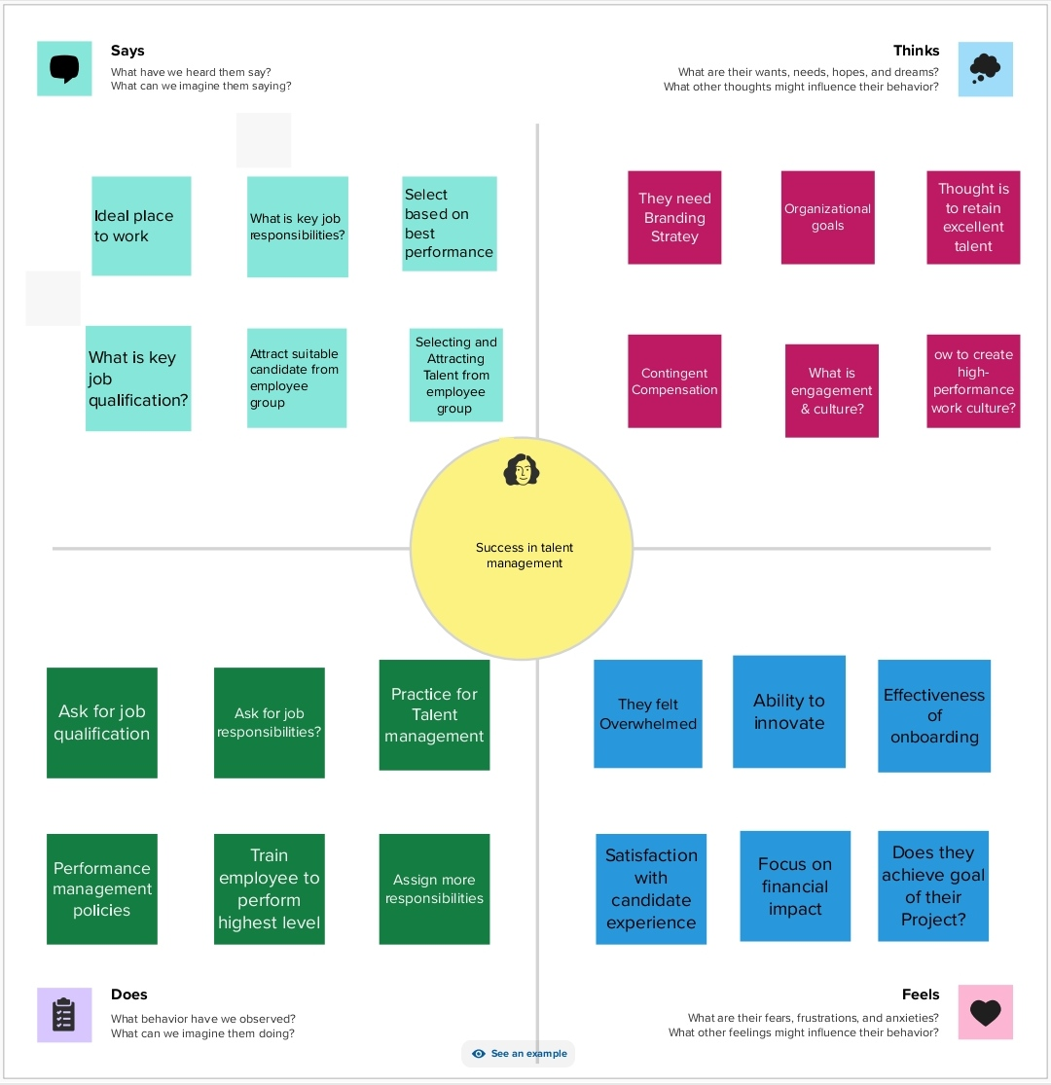
2. DEFINITION OF PROBLEM & DESIGN THINKING
EMPATHY MAP

Slide 5
3.ACTIVITY NAMES
COST FOR ESTIMATION
PLANNED VS ACTUAL BUSINESS EXPENSES ESTIMATE
ESTIMATING METHODS
ORGANISATION IN PAST 12 MONTHS
PIE GRAPH
LAYER PRESENTING BUSINESS EXPENSES
PROCUREMENT COST SAVING

Slide 6
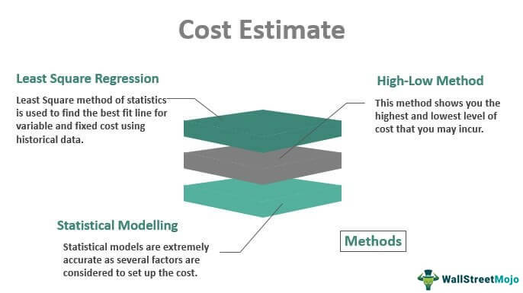
ACTIVITY AND SCREENSHOT

Slide 7
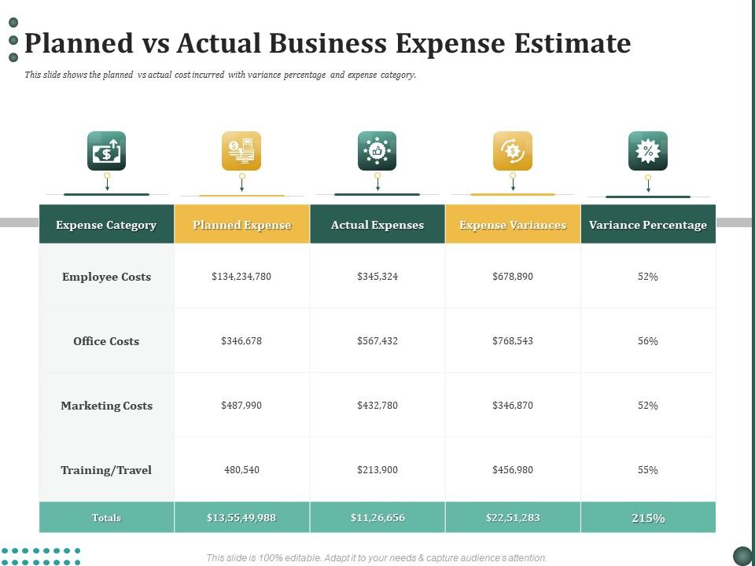

Slide 8
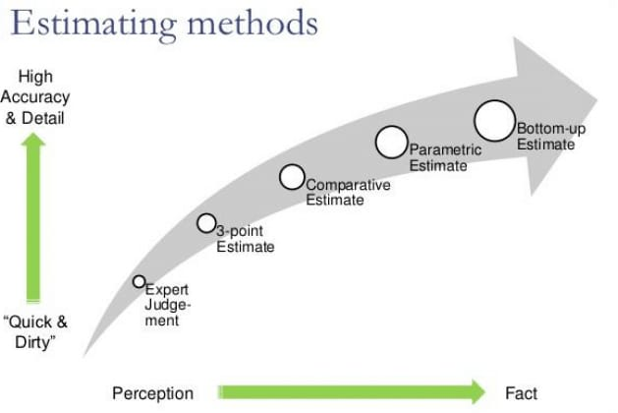

Slide 9
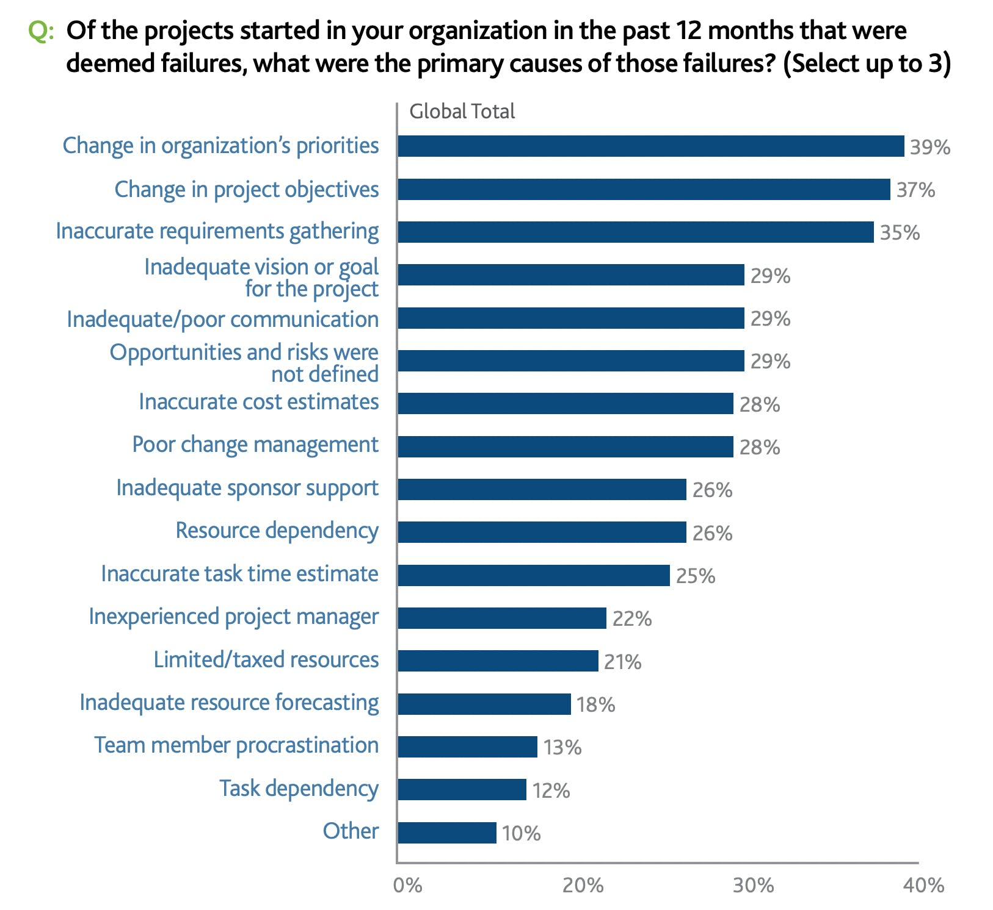
Add a Slide Title - 4

Slide 10
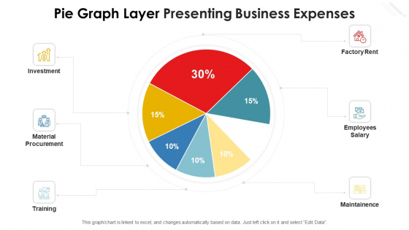

Slide 11
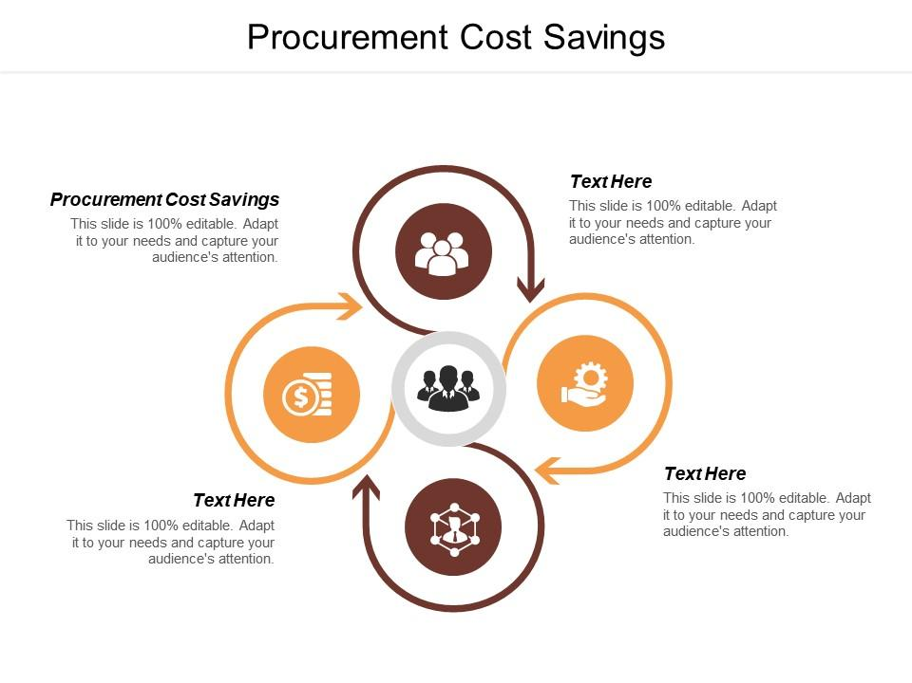

Slide 12
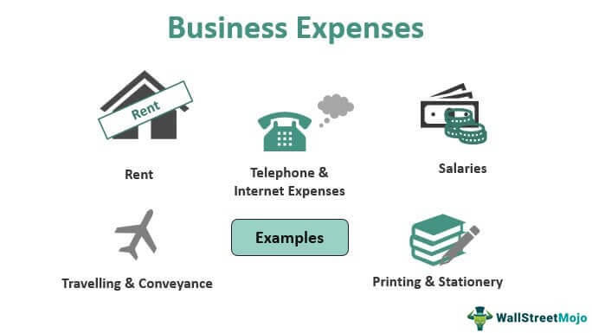
Add a Slide Title - 2

Slide 13
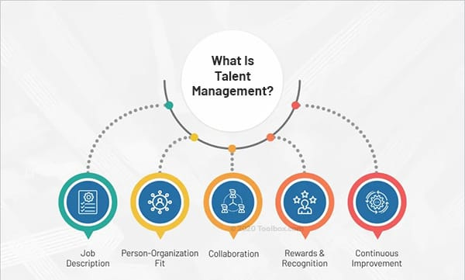
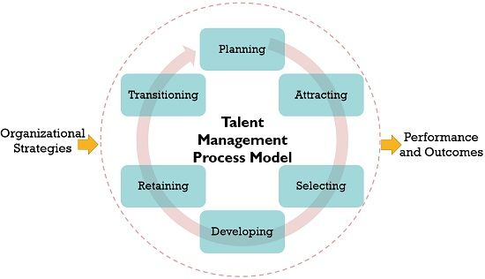
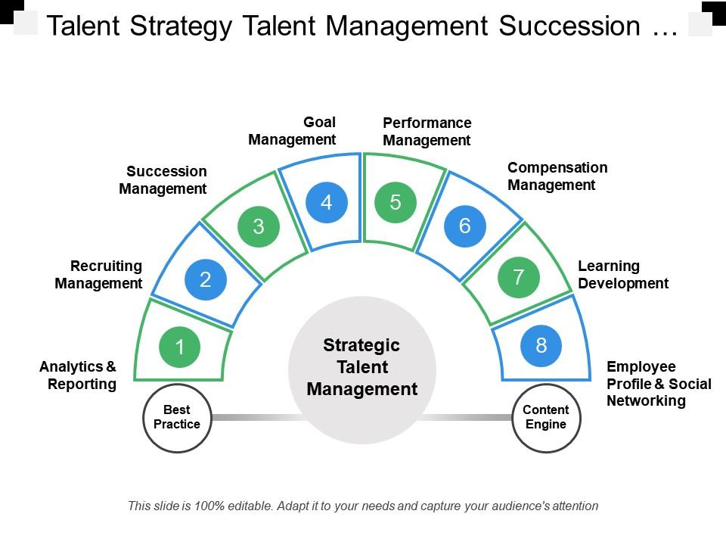
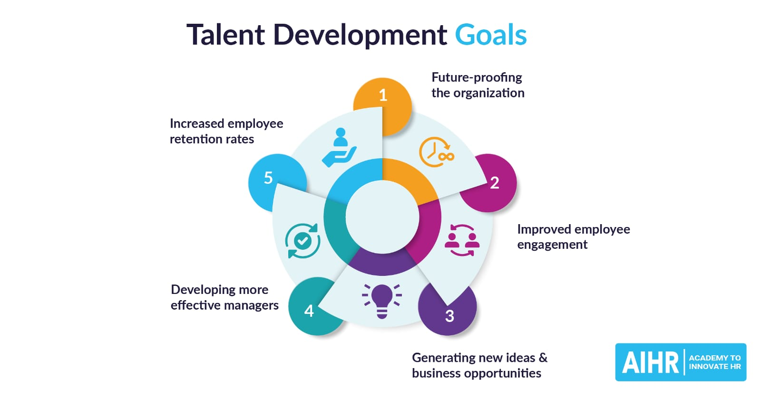
Add a Slide Title - 3

Slide 14
ESTIMATION OF BUSINESS EXPENSES
ADVANTAGES
DISADVANTAGES
It allows you to know whether you need to raise .
If you keep it at a steady cost.
Helps you determine your projects budget
More accurate estimation
Result in smoother execution
It can be expensive to implement and its time
It is not flexible enough to answer
The product specification must be well-know
It is not relatively accurate
New estimate must be built for each alternative

Slide 15
APPLICATION OF COST ESTIMATION
Cost estimation helps you determine your project's budget, schedule the work necessary and manage new resources. Cost estimates are also very crucial when it comes to winning new business. Property owners also use cost estimates to assess the feasibility of their projects before embarking on actual construction.

Slide 16
FUTURE SCOPE
COST ESTIMATION :Cost estimation in project management is the process of forecasting the financial and other resources needed to complete a project within a defined scope.
PROJECT BUDGET : Cost estimation accounts for each element required for the project — from materials to labor — and calculates a total amount that determines a project's budget.
BENEFIT OF ESTIMATION : These benefits include budget planning, resource allocation, risk management, improved decision-making, and competitive advantage.
INDUSTRIES: Using cost estimation, organizations can ensure the success of their projects and maintain a competitive edge in their respective industries.
PROCUREMENT COST SAVING : companies can negotiate better terms and conditions with their suppliers, leading to improved supplier relationships and increased cooperation

Slide 17
CONCLUSION
Cost estimation is an important component of project management that ensures projects are finished on schedule and within budget.
Since inaccurate cost estimates can have serious financial consequences for businesses, accurate cost estimating is crucial for all stakeholders engaged in a project.
Since inaccurate cost estimates can have serious financial consequences for businesses, accurate cost estimating is crucial for all stakeholders engaged in a project.

Slide 18
THANK YOU!

